Slide 1



Cyber Offense and Defense
HTTP request smuggling
Group 1
Main References
https://portswigger.net/web-security/request-smuggling#what-is-http-request-smuggling

Slide 2
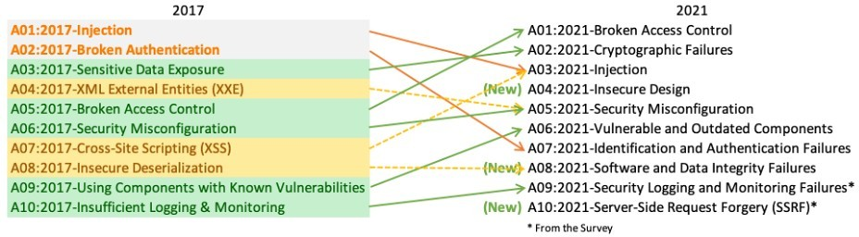
OWASP Top Ten
A broad consensus about the most critical security risks to web applications
A??:2017: HTTP Request Smuggling

Slide 3
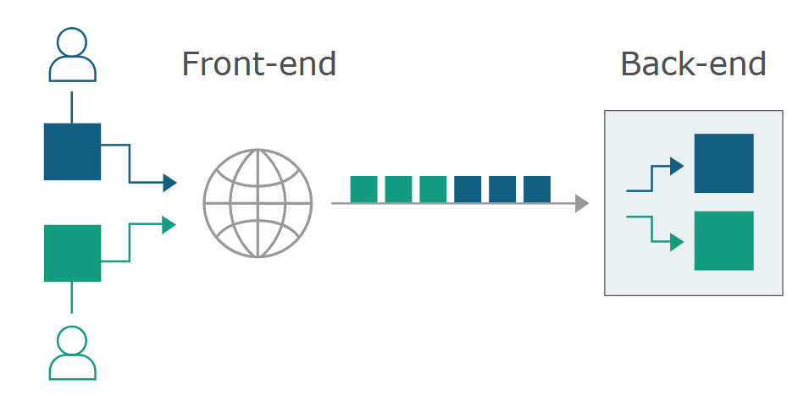
HTTP request smuggling
HTTP request smuggling is a technique for interfering with the way a web site processes sequences of HTTP requests that are received from one or more users.
When the front-end server forwards HTTP requests to a back-end server, it typically sends several requests over the same back-end network connection, because this is much more efficient and performant. The protocol is very simple; HTTP requests are sent one after another, and the receiving server has to determine where one request ends and the next one begins

Slide 4
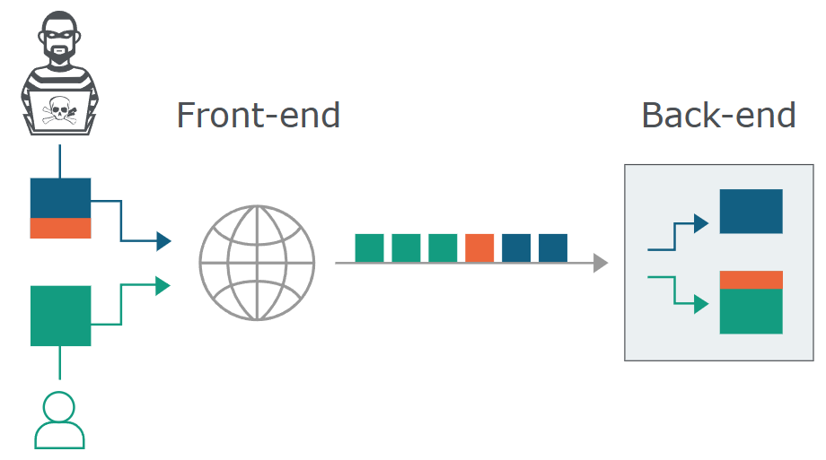
HTTP request smuggling
It is crucial that the front-end and back-end systems agree about the boundaries between requests. Otherwise, an attacker might be able to send an ambiguous request that gets interpreted differently by the front-end and back-end systems

Slide 5
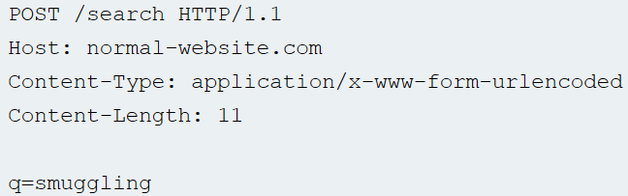
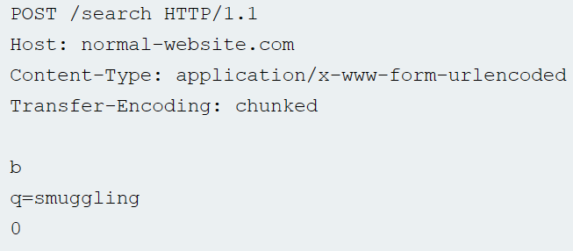
Most HTTP request smuggling vulnerabilities arise because the HTTP/1 specification provides two different ways to specify where a request ends:
Content-Length: it specifies the length of the message body in bytes
Transfer-Encoding: used to specify that the message body uses chunked encoding
After specify the size of the chunk, the next line will contain the real content. If the chunk is 0, the next line has to be empty

Slide 6
HTTP/1 specification provides two different methods for specifying the length of HTTP messages.
If both the Content-Length and Transfer-Encoding headers are present, then the Content-Length header should be ignored
Some servers do not support the Transfer-Encoding header in requests
Some servers that do support the Transfer-Encoding header can be induced not to process it if the header is obfuscated in some way.
This might be sufficient to avoid ambiguity when only a single server is in play, but not when two or more servers are chained together
The front-end and back-end servers might disagree about the boundaries between successive requests, leading to request smuggling vulnerabilities.

Slide 7

ZAP
"\r" (carriage return)
"\n" (line feed)
"\r\n" is the sequence that indicates the end of a line in the HTTP header

Slide 8
How to obfuscate the Transfer-Encoding header
Transfer-Encoding: xchunked
Transfer-Encoding : chunked
Transfer-Encoding: chunked
Transfer-Encoding: x
Transfer-Encoding:[tab]chunked
[space]Transfer-Encoding: chunked
X: X[\n]Transfer-Encoding: chunked
Transfer-Encoding
: chunked

Slide 9


Questions

